Slide 1

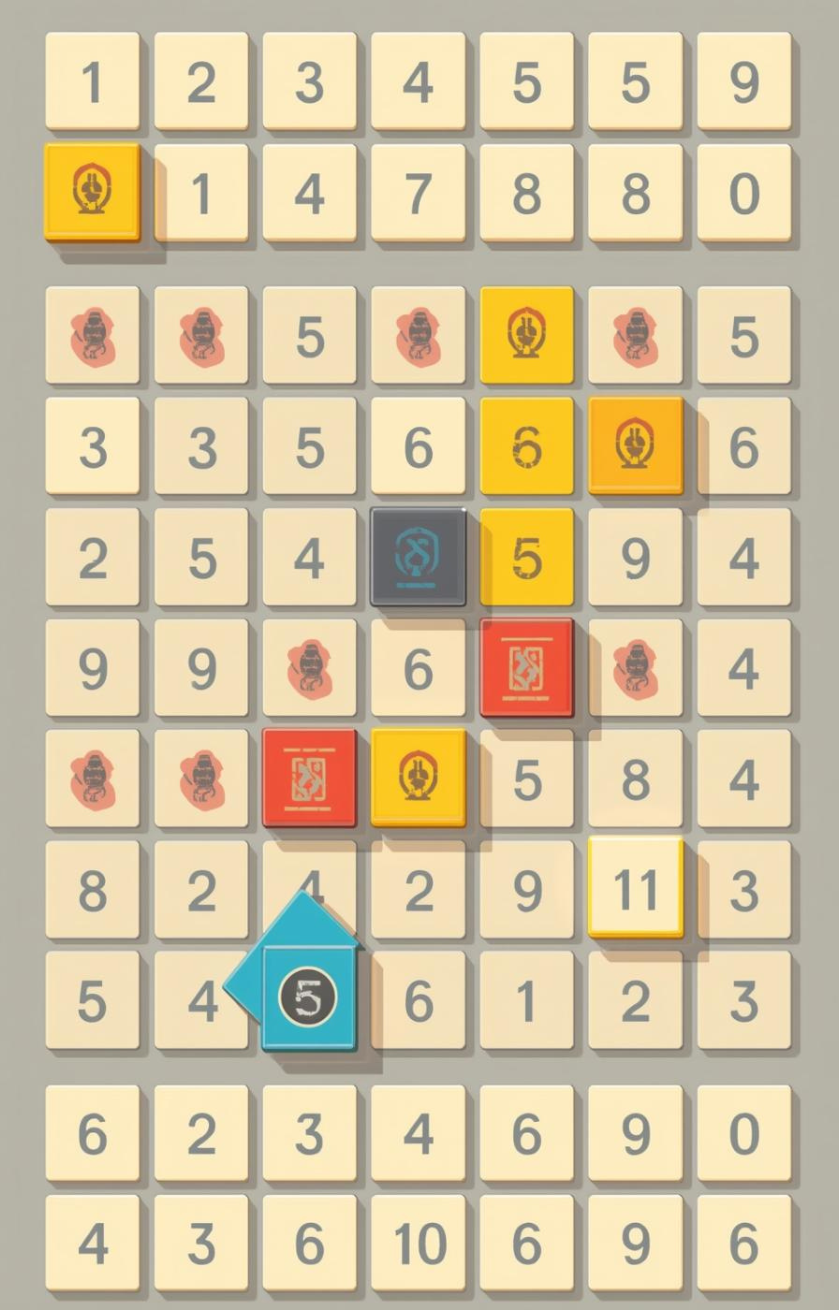


Kode Insignia
Gaming the Models

Slide 2
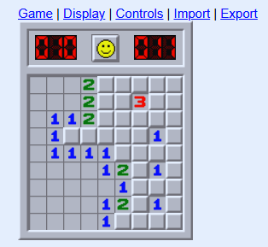
Why Minesweeper is Ideal for AI
Minesweeper presents a unique challenge for AI training due to its need for logical reasoning and pattern recognition. The game involves uncertainty and requires probabilistic decision-making skills, making it an excellent learning opportunity.

Slide 3

Approach to Training and Tuning
  Data input using visual game representations for training
  Reinforcement learning enhances decision-making through iterative feedback
  Parameter tuning optimizes accuracy and speeds up responses

Slide 4
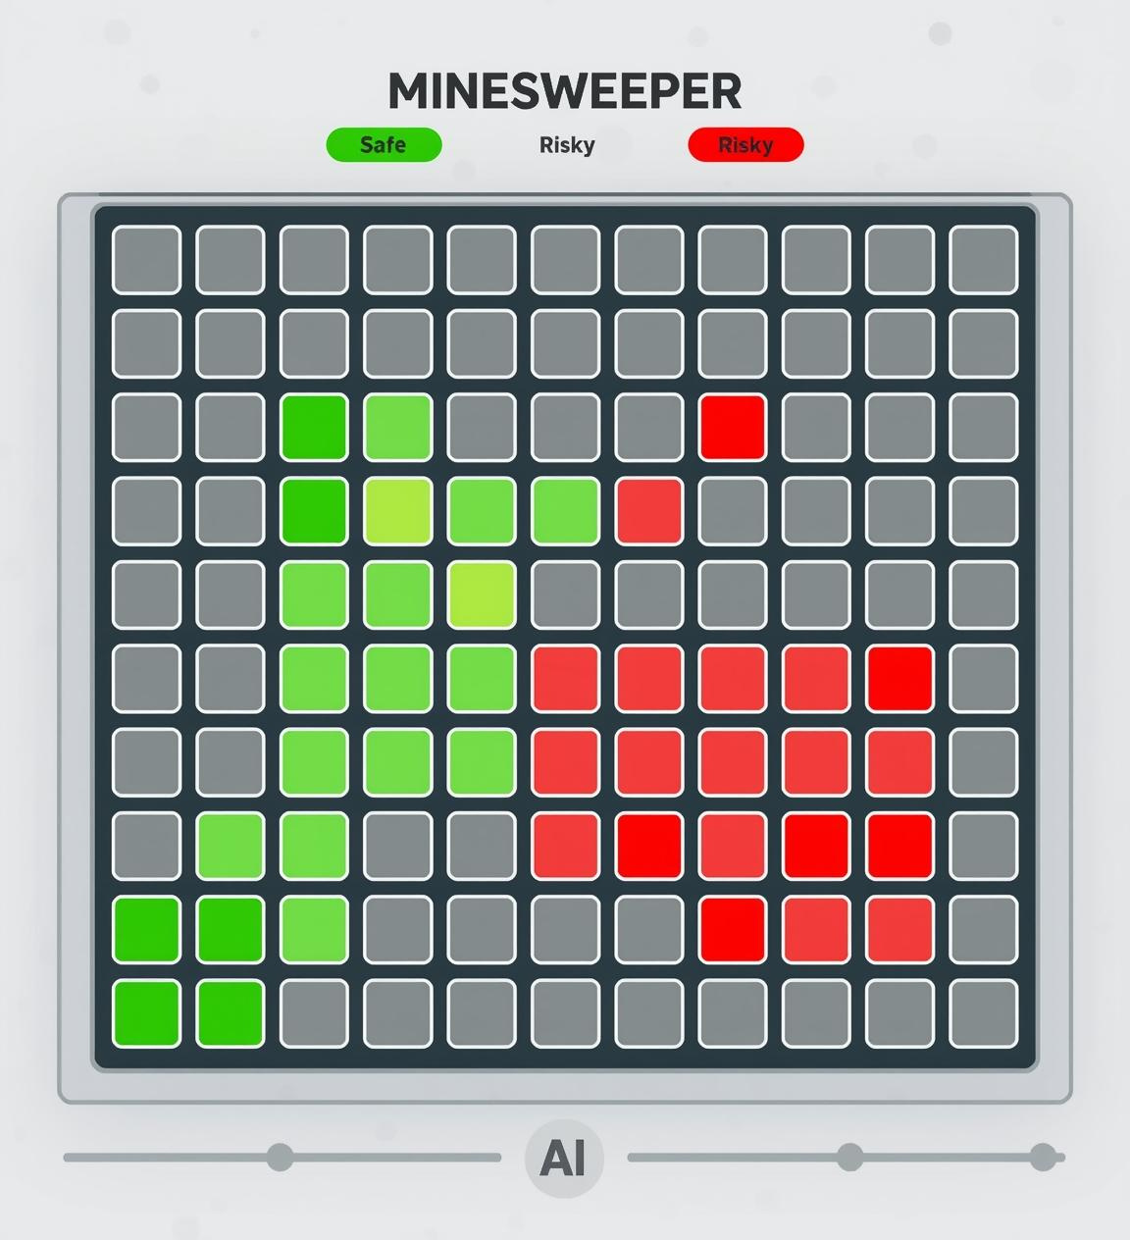
Improve Model – Strategies
1. Adjust Reward Functions
• Reward logical deduction
• Penalize random moves
• Reward correct mine flagging
2. Tune Hyperparameters
• Increase for longer training
• Adjust (1e-5 → 1e-4)
• Increase for more capacity
• Adjust (2–8)
3. Better Training Data
• Generate diverse states
• Include harder scenarios (more mines)
• Add deduction-heavy states
4. Advanced Techniques
• Multi-step rollouts in reward function
• Curriculum learning (easy → hard boards)
• Ensemble multiple models

Slide 5
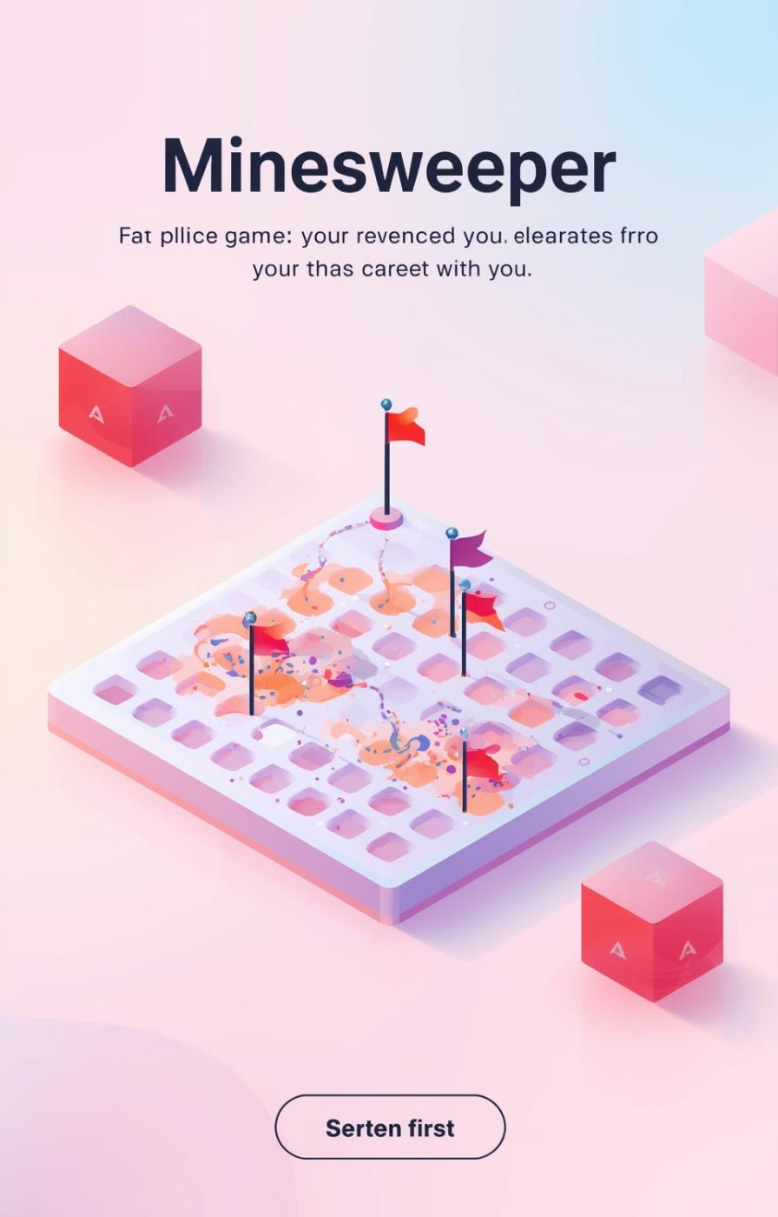
Team Strategy
  Experiment with reward functions
  Try different board sizes during training
  Analyze failed games to refine rewards
  Use temperature sampling during evaluation

